Slide 1
Interpolation
Topic: Newton’s Divided Difference Polynomial Method
Major: General

Slide 2
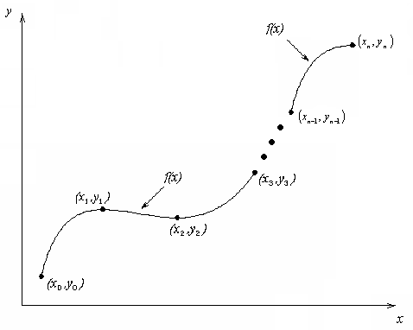
What is Interpolation ?
Given (x₀,y₀), (x₁,y₁), …… (x_{n},y_{n}), find the value of ‘y’ at a value of ‘x’ that is not given.

Slide 3

Interpolants
Polynomials are the most common choice of interpolants because they are easy to:
  Evaluate
  Differentiate, and
  Integrate.

Slide 4



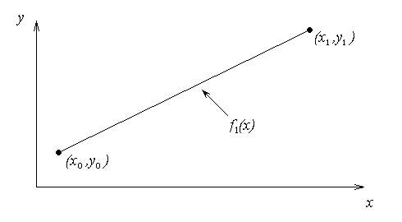

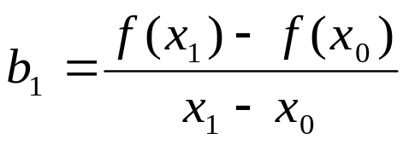
Newton’s Divided Difference Method
Linear interpolation: Given pass a linear interpolant through the data
where

Slide 5
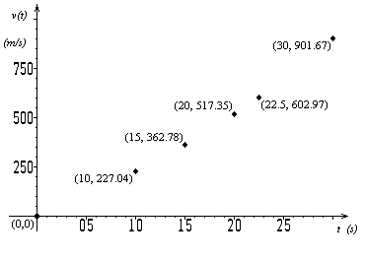

Example
The upward velocity of a rocket is given as a function of time in Table 1. Find the velocity at t=16 seconds using the Newton Divided Difference method for linear interpolation.
t | v(t)
s | m/s
0 | 0
10 | 227.04
15 | 362.78
20 | 517.35
22.5 | 602.97
30 | 901.67
Table 1: Velocity as a
function of time
Figure 2: Velocity vs. time data
for the rocket example

Slide 6
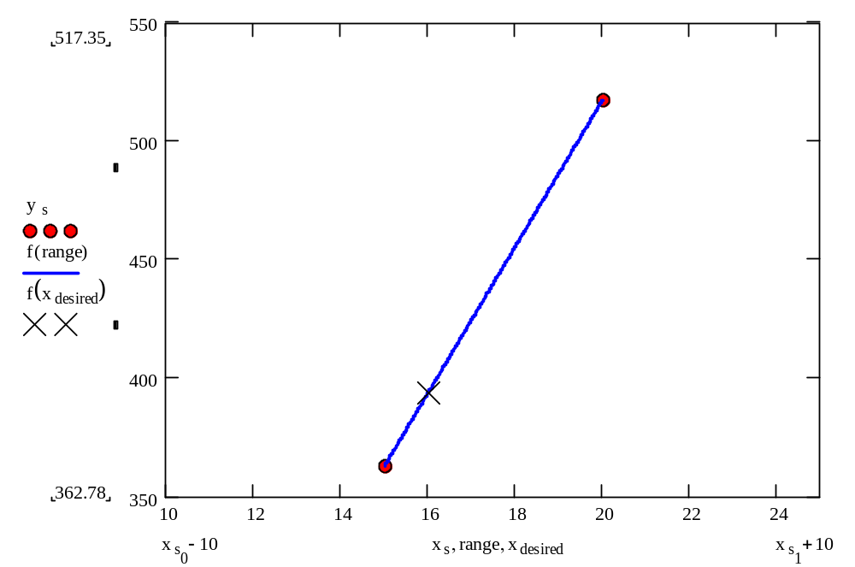
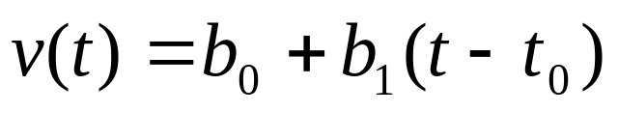
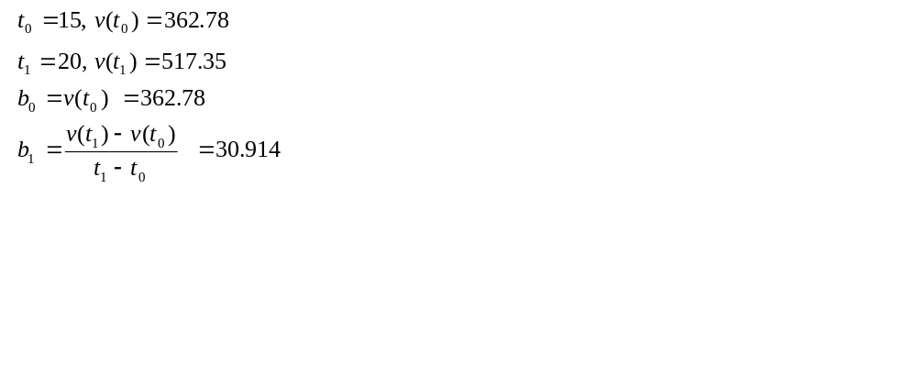
Linear Interpolation

Slide 7
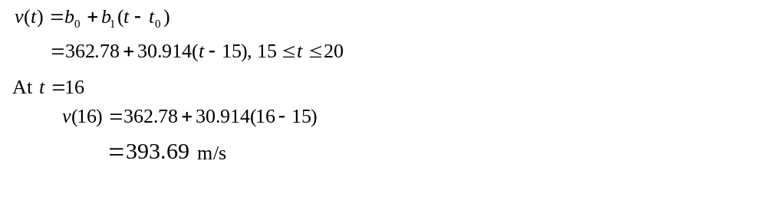
Linear Interpolation (contd)

Slide 8

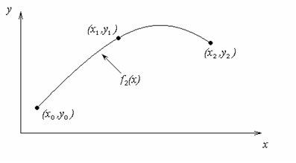
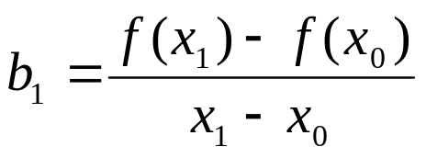
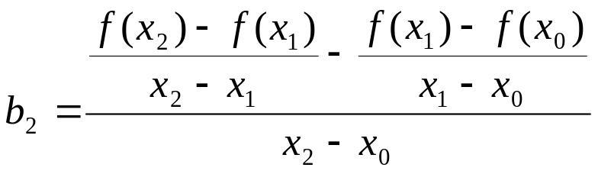
Quadratic Interpolation

Slide 9
Example
The upward velocity of a rocket is given as a function of time in Table 1. Find the velocity at t=16 seconds using the Newton Divided Difference method for quadratic interpolation.
t | v(t)
s | m/s
0 | 0
10 | 227.04
15 | 362.78
20 | 517.35
22.5 | 602.97
30 | 901.67
Table 1: Velocity as a
function of time
Figure 2: Velocity vs. time data
for the rocket example

Slide 10
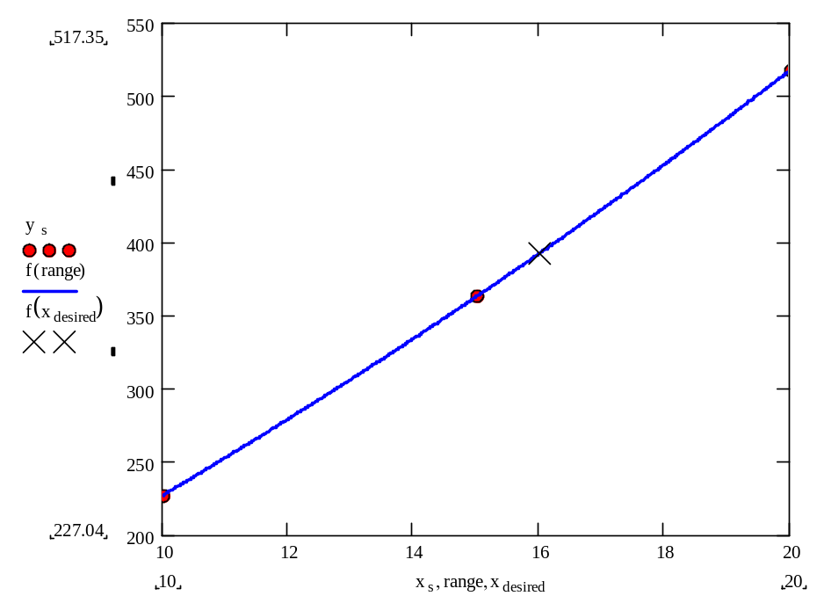
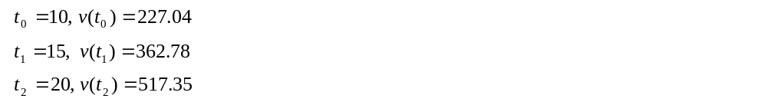
Quadratic Interpolation (contd)

Slide 11
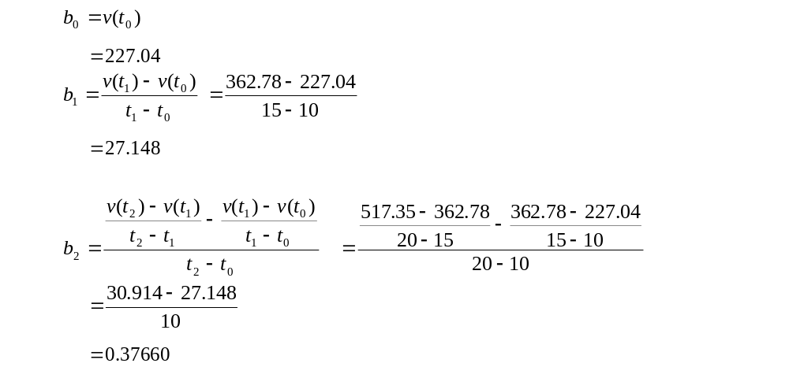
Quadratic Interpolation (contd)

Slide 12
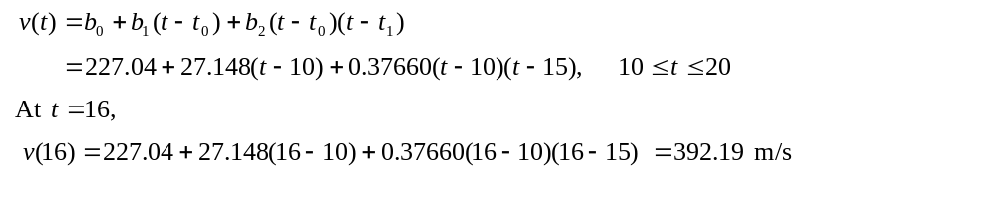
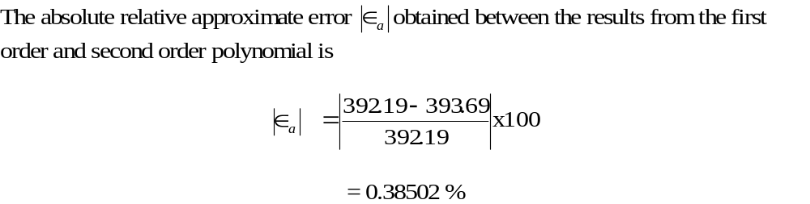
Quadratic Interpolation (contd)

Slide 13
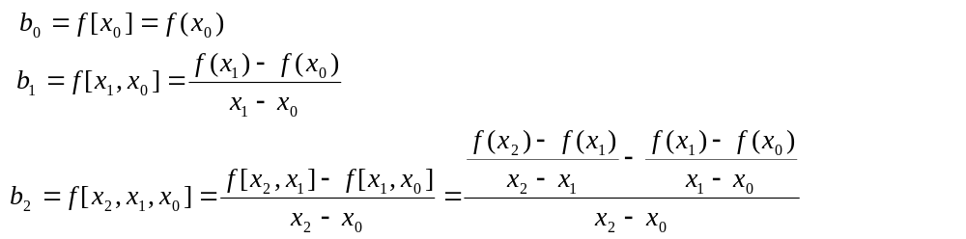
General Form
where
Rewriting

Slide 14
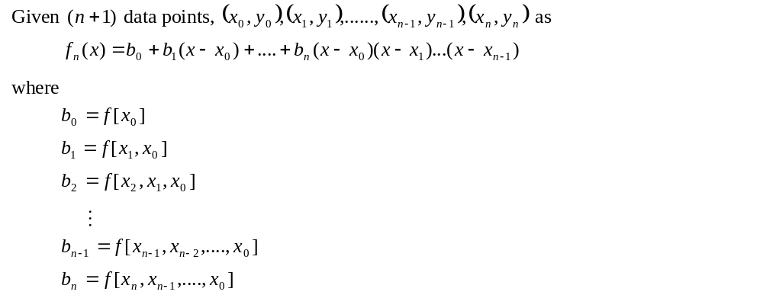
General Form

Slide 15
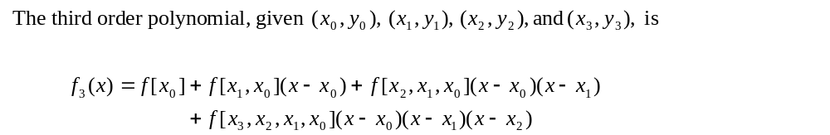
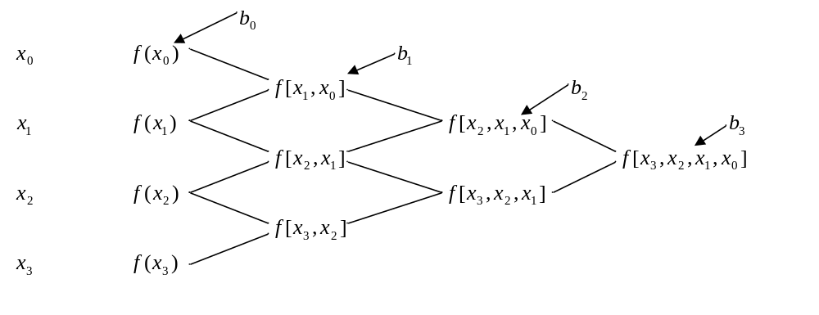
General form

Slide 16
Example
The upward velocity of a rocket is given as a function of time in Table 1. Find the velocity at t=16 seconds using the Newton Divided Difference method for cubic interpolation.
t | v(t)
s | m/s
0 | 0
10 | 227.04
15 | 362.78
20 | 517.35
22.5 | 602.97
30 | 901.67
Table 1: Velocity as a
function of time
Figure 2: Velocity vs. time data
for the rocket example

Slide 17

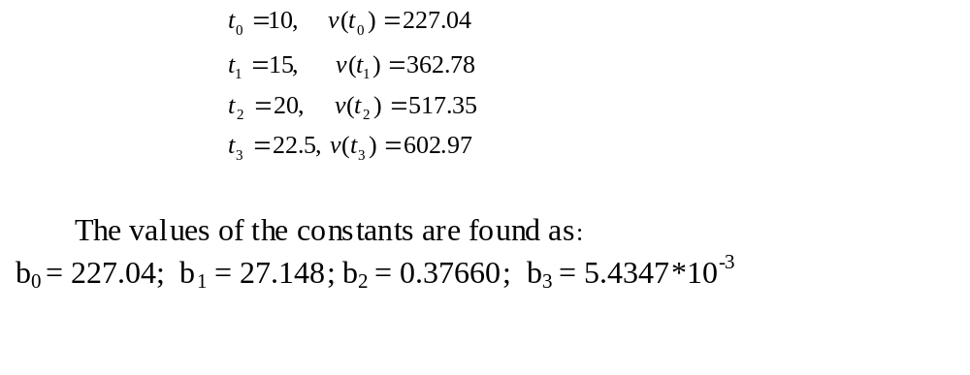
Example
The velocity profile is chosen as
we need to choose four data points that are closest to

Slide 18
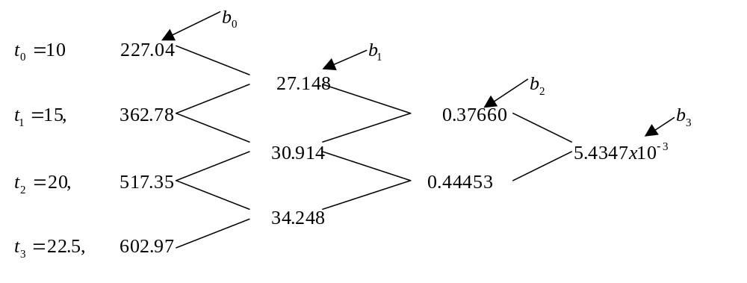
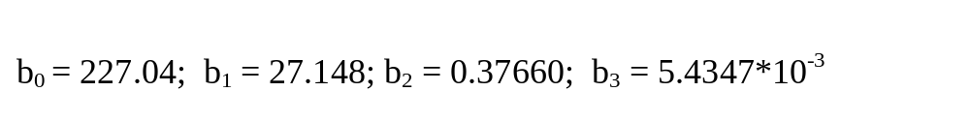
Example

Slide 19
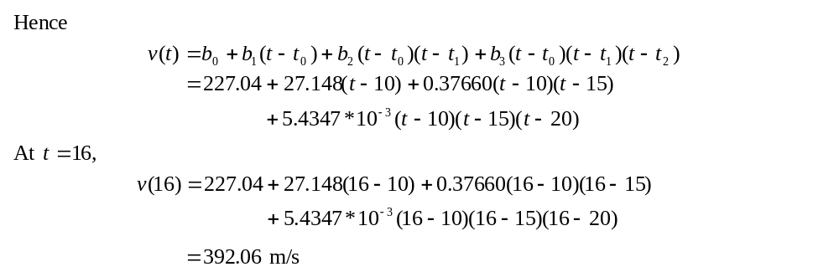

Example

Slide 20
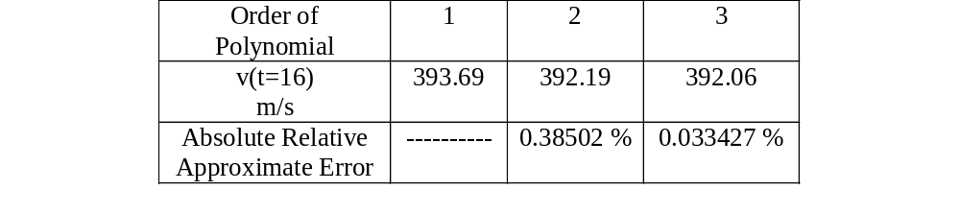
Comparison Table

Slide 21
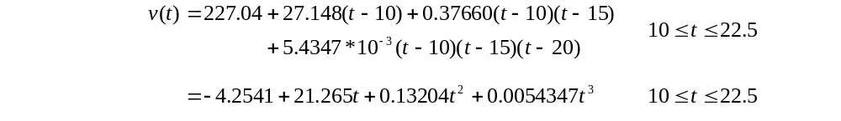
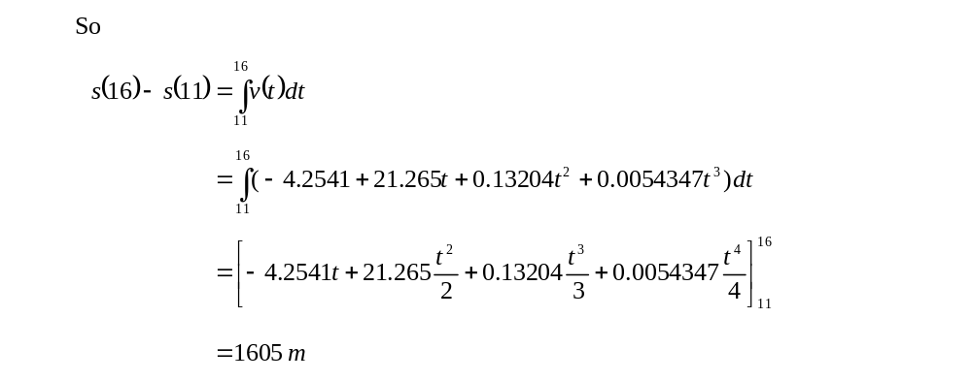
Distance from Velocity Profile
Find the distance covered by the rocket from t=11s to
t=16s ?

Slide 22
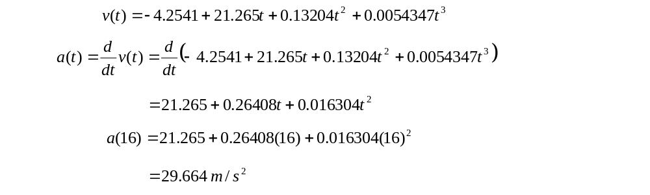
Acceleration from Velocity Profile
Find the acceleration of the rocket at t=16s given that

